Slide 1
Prize-Linked Savings Accounts and Moral Licensing K. Atalay, F. Bakhtiar, S. Cheung, R. Slonim; & K. Atalay, E. Garbarino, S. Guney and R. Slonim
Workshop in Experimental Methods for Social Science & Business:
“Interdisciplinary Experiments”
6 November, 2014

Slide 2
Motivation
Inadequate Savings Among Low Income HHs
½ Survey respondents cannot come up with $2,000 (Lusardi et al 2011), yet consumption shocks > $2,000 routine (Blundell et al 2008)
Extensive theoretical and empirical work in economics (Crossley et al 2012 survey), yet solutions remain unclear
We study Prize Linked Savings (PLS) Accounts as a potential solution

Slide 3
PLS - Background
PLS combines traditional savings account feature of guaranteed principal with a lottery with a large (life changing) payoff.
Lottery appeal in US (Kearney et al. 2011):
$540 expenditure per year in US
Proportion of income spent on lotteries negatively correlated with income

Slide 4
Limited Evidence
Macro level:
High demand outside US (in over 20 countries) dating to 1694 in the UK (Lobe & Holzl 2007; Murphy 2005; Tufano 2008)
Micro level:
PLS accounts are particularly appealing to heavy lottery players, non-savers and low-savers (Tufano et al 2011)
Notes:
Macro – Averages, lacking distributional effects, who is buying, …
Micro – survey, and two important unanswered questions.

Slide 5
Unanswered Questions
Does the introduction of a PLS product increase total savings (addresses illiquidity problem), and if so, what are the sources of the expenditures?
If PLS products increase total savings, then why, theoretically, do individuals demand PLS accounts rather than invest in traditional savings accounts and buy lottery tickets? We can reject common economic explanations (e.g. RDEU; CPT; Skewness)
We propose that Moral Licensing, studied by psychologists, offers the most credible explanation for the data. We are now testing this conjecture.
Notes:
1 and 2 we answer in this paper – 3 we find profoundly unaddressed, and critical. If can do better with your own combinations than the PLS offered, why still buy the PLS … Bundling and Moral Licensing seem the likely story ….

Slide 6
Design
Subjects budget was $100 to spend on up to four options. If spend X on an option:
Early Payoff 10 Weeks Later
Cash $X $0
Traditional Savings $0 $X*(1+r)
Lottery $0 $1,000 w p_{L}(x)
PLS $0 $X + ($1,000 w p_{PLS}(x))

Slide 7
Design
Order the same for all subjects:
Practice:
Paid one of the following:
C) Decisions 7-15: Cash, Trad. Savings. Lotteries
D) Decisions 16-30: Cash, Trad. Sav., Lotteries, PLS
Within Subject design:
Focus on how subjects allocations are affected by the introduction of the PLS accounts (D vs. C) and
Examine how the interest rate, lottery odds and PLS odds affect the allocation decisions

Slide 8
Design
Details:
Online internet study
Randomization for lottery done by combining last two digits of three stock indices on specified future date
Subjects recruited from StudyResponse (SR) & Mturk
SR: Had 10% of getting paid for one decision.
SR: Representative of US Population
Mturk: Identical to SR, except hypothetical
Mturk: Lower Income, Less Savings, much larger sample

Slide 9
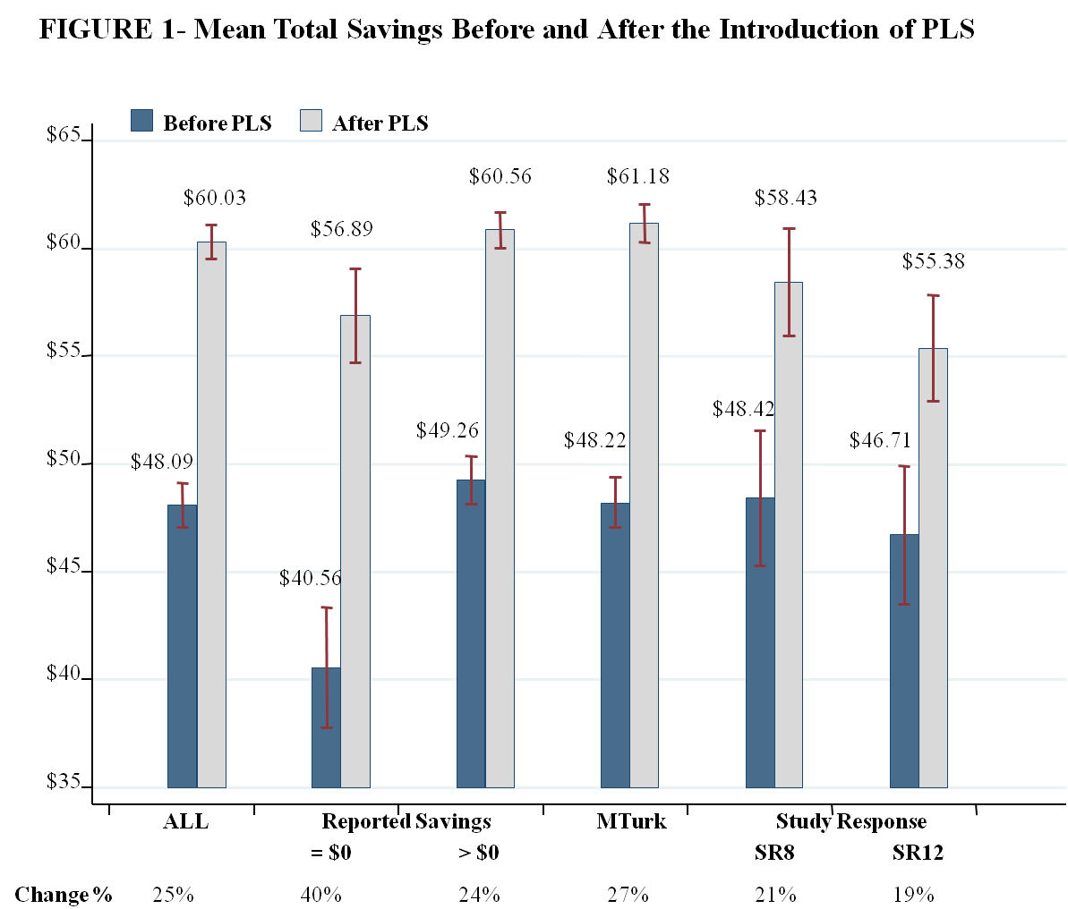
Result 1: PLS Increases Savings

Slide 10
Some robustness checks
Varied choice increments ($1 or $20)
Econometric specifications
Inclusion & exclusion of controls
Inclusion & exclusion of treatments (r, p_{L}, p_{PLS})
Interactions
Sample: Mturk only; SR only
Etc. …..

Slide 11
Why Demand for PLS (1)
When PLS has better odds than the portfolio that can be made from lottery and traditional savings, 70% of subjects had positive expenditures for the PLS account.
When PLS has the same odds as the portfolio that can be made from lottery and traditional savings, 67% of subjects had positive expenditures for the PLS account.
When PLS has worse odds than the portfolio that can be made from lottery and traditional savings, 64% of subjects had positive expenditures for the PLS account.
In other words: Why do subjects prefer the pre-packaged than the do-it-yourself bundle?

Slide 12
Why Demand for PLS (2)
Moral Licensing:
In general, doing a good (moral) act permits license to do a not so good (moral) act (Merritt et al 2010).
Our simplest (economic) interpretation:
u(C, M); u’ > 0; u’’ < 0
Where M = moral – immoral acts
Moral Wiggle room:
In general, moral wigglers look for excuses to justify not doing what is morally right, or, moral wigglers look for excuses to justify doing what is not morally right.

Slide 13
Why Demand for PLS (2)
Lotteries have negative moral connotation
E.g., Moore & Ohtsuka (1999) survey: agree, strongly agree
55%: “gambling destroys families,”
23%: “gambling is a social evil”
In contrast, savings likely has positive moral connotations
The pre-packaged bundle allows individuals to not buy the lottery in isolation, thus can avoid an action that has the negative moral connotation only (i.e., PLS introduces wiggle room on gambling)

Slide 14
Extensions
ML and:
Institutions: Can the institution aid moral license?
More to come
Context and Framing (savings vs. gambling)
Structure
……..

Slide 15
Extensions
Can the institution aid moral license?
Mturk Survey (n=299):
Options to spend $1,000: (Within Subjects)
CD, Lottery, Cash (Other), PLS
Same order: Questions before and after PLS Introduced
Who offers PLS (Between Subjects)
Bank, Casino or Charity
For all, subjects told all fully safe, reliable, …
Very Preliminary Results:

Slide 16
Interest In PLS
1= Not at all int; 7=Very interested
Likely to spend on PLS
1= Not at all int;7=Very likely
4
4
3
3
2
2
1
1
Bank
Casino
Charity
Bank
Casino
Charity
PLS offered by

Slide 17
Mean Spending on PLS - $1,000 Budget
200
150
100
50
0
PLS offered by
Bank
Casino
Charity

Slide 18
Mean Total Savings before and after PLS introduction
$500
Before
After
$400
$300
$200
$100
PLS offered by
Bank
Casino
Charity
Change %
38 %
17 %
40 %

Slide 19
Results & Robustness
Key results:
(1) If PLS is offered by a bank rather than a casino, then:
Greater interest in the PLS,
More likely to spend on the PLS, and
Allocate more of one’s budget towards the PLS
(2) Savings increases significantly more when PLS is offered by a bank (or charity) than by a casino.
Controls for demographics
Controls for attitudes (e.g. risks, gambling, savings)
Econometric specifications

Slide 20
Summary
PLS accounts increased savings
Sources were lottery and current consumption
Effects larger for low income HHs
Standard theories (RDEU, CPT, Skewness), cannot explain demand for PLS
Moral licensing or moral wiggle room offer a possible explanation
Institutions Matter
Will policy-makers endorse a savings instrument that includes a lottery component?
Parallels to states introducing lotteries

Slide 21
Result 1 B: PLS increases savings Low Income Sample (76 subjects)
 | - Linear Regression
Dependent Variable | Total Savings ( Traditional Savings +PLS ) |  |  | Future Guaranteed Savings (T. Savings*(1+r) + PLS)
 | (1) |  | (2) | (3)
PLS introduced | 16.33*** |  | 15.02*** | 14.57***
 | (1.17) |  | (2.89) | (2.99)
Price Controls
Fair PLS odds |  |  | 0.61(1.03) | 0.51(1.05)
Good PLS odds |  |  | 1.74 (1.23) | 1.54 (1.3)
Fair lottery odds |  |  | -0.22 (0.95) | -0.28 (1.03)
Good lottery odds |  |  | -0.14 (1.18) | -0.22 (1.28)
10% interest rate |  |  | 9.14*** (2.52) | 11.91*** (2.68)
20% interest rate |  |  | 14.25*** (3.18) | 22.06*** (3.59)
Adjusted R² | 0.59 |  | 0.61 | 0.63
Fixed Effects | Yes |  | Yes | Yes
Mean allocation before PLS |  | 44.06

